Slide 1
THE HUNDRED DRESSES
PART I & II
By: Eleanor Estes

Slide 2
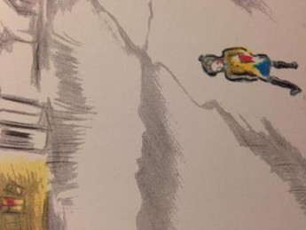

Slide 3
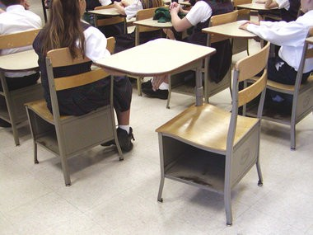

Slide 6
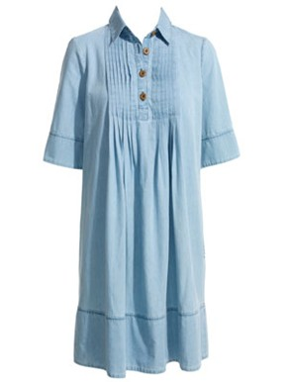

Slide 7
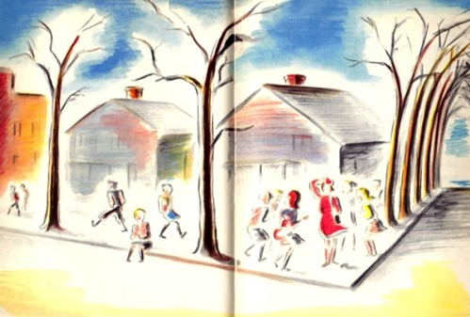

Slide 8
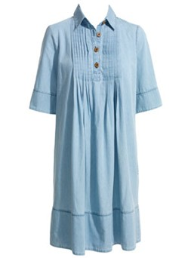

Slide 9
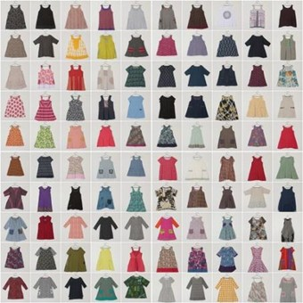
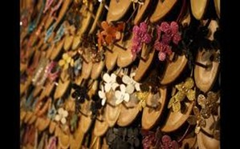

Slide 10
STARTING JOURNESTARTING JOURNEY:
1976 (FROM PLYMOUTH)
ACCOMPANIED BY WIFE MARY,SON JONATHAN,DAUGHTER SUZZANE
Y:
1976 (FROM PLYSTARTING JOURNEY:
1976 (FROM PLYMOUTH)
ACCOMPASTARTING JOURNEY:
1976 (FROM PLYMOUTH)
ACCOMPANIESTARTING JOURNEY:
1976 (FROM PLYMOUTH)
ACCOMPANIED BY WIFE MARY,SON JONATHAN,DAUGHTER SUZZANE
D BY WIFE MARY,SON JONATHAN,DAUGHTER SUZZANE
NIED BY WIFE MARY,SON JONATHAN,DAUGHTER SUZZANE
MOUTH)
ACCOMPANIED BY WIFE MARY,SON JONATHAN,DAUGHTER SUZZANE

Slide 11
STARTING JOURNEY:
1976 (FROM PLYMOUTH)
ACCOMPANIED BY WIFE MARY,SON JONATHAN,DAUGHTER SUZZANE
STARTING JOURNEY:
1976 (FROM PLYMOUTH)
ACCOMPANIED BY WIFE MARY,SON JONATHAN,DAUGHTER SUZZANE

Slide 12
CREWMEN – LARRY VIGIL AND
SWISS HERB SEIGLER

Slide 13
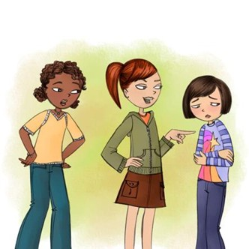

Slide 14
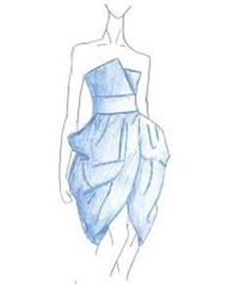

Slide 17
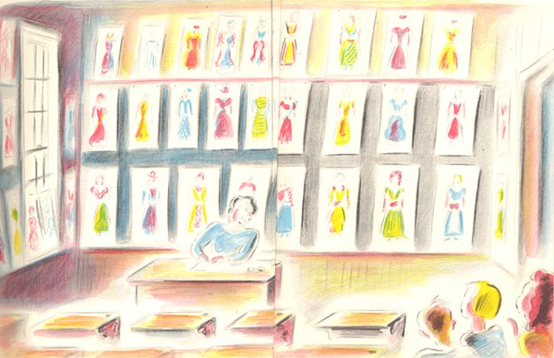

Slide 18
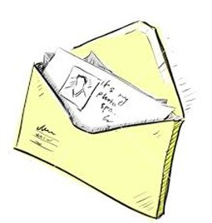

Slide 20
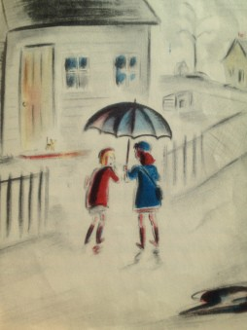

Slide 21
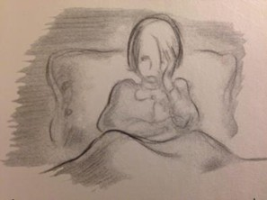

Slide 23
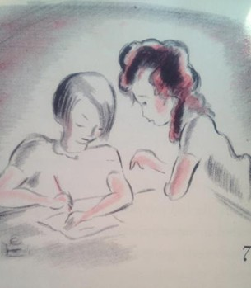

Slide 24
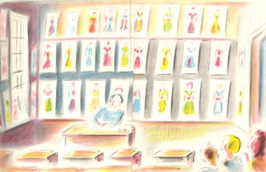

Slide 25
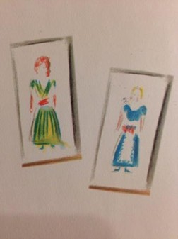

Slide 26
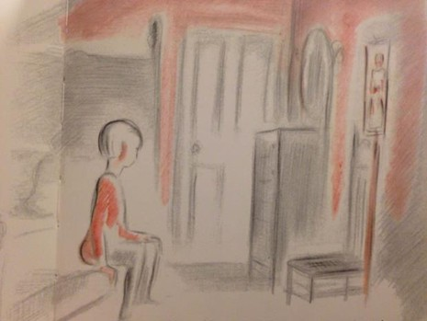

Slide 27
